Slide 1
«Past Simple»

Slide 2
позавчера
в прошлом году
неделю тому назад
10 дней тому назад
прошлым летом
вчера
месяц тому назад
ten days ago
last summer
yesterday
a week ago
the day before yesterday
last year
a month ago

Slide 3
Все глаголы делятся на
правильные Regular verbs и неправильные Irregular verbs

Slide 4
Правильные глаголы
V → V + ed
Help + ed → helped
Play + ed → played
Cry + ed → cried
Stop + ed → stopped
Travel + ed → travelled

Slide 5

Образуйте форму прошедшего времени
live enjoy stay
decide study use
hate love stop

Slide 6
Окончание –ed произносится
[d]
Opened
Closed
Tried
Lived
studied
[t]
Worked
Cooked
Checked
Helped
Mixed
[id]
Attended
Decided
Acted
Visited
needed

Slide 7
Назовите 2 форму глаголов
be -
was/were
take -
took
go -
went
see -
saw
read -
read
run -
ran
meet -
met
have -
had

Slide 8
Сравните:
I went to school yesterday.
Girls played volleyball.
Mom watched a film.
I go to school every day
Boys play football.
Grandma watches TV in the living room.

Slide 9
Раскройте скобки и поставьте глагол в нужную форму
I … my hands and face. (wash)
Children… in a local hospital. (help)
We … in the river in summer. (swim)
Tom … his friend last week. (meet)
My sister … dinner yesterday. (cook)

Slide 10
Расскажите о том,
что вы делали вчера
с друзьями

Slide 11
Чтобы задать вопрос или составить отрицательное предложение на помощь приходит вспомогательный глагол
did

Slide 12
Barash
slept
yesterday.
sleep
yesterday
?
Did
Barash
did not
sleep
Barash
yesterday.

Slide 13
Задайте вопросы
My father went to the cinema yesterday.
Did my father go to the cinema yesterday?
His sister bought a new dress last week.
Did his sister buy a new dress last week?
A dog ate a bone.
Did a dog eat a bone?

Slide 14
Глагол – связка to be
1. I was
2. You were
3. He was
She was
It was
1. We were
2. You were
3. They were

Slide 15
Как задать вопрос?
Was he happy?
Were they happy?

Slide 16
Отрицательные формы
was not = wasn’t
were not = weren’t

Slide 17
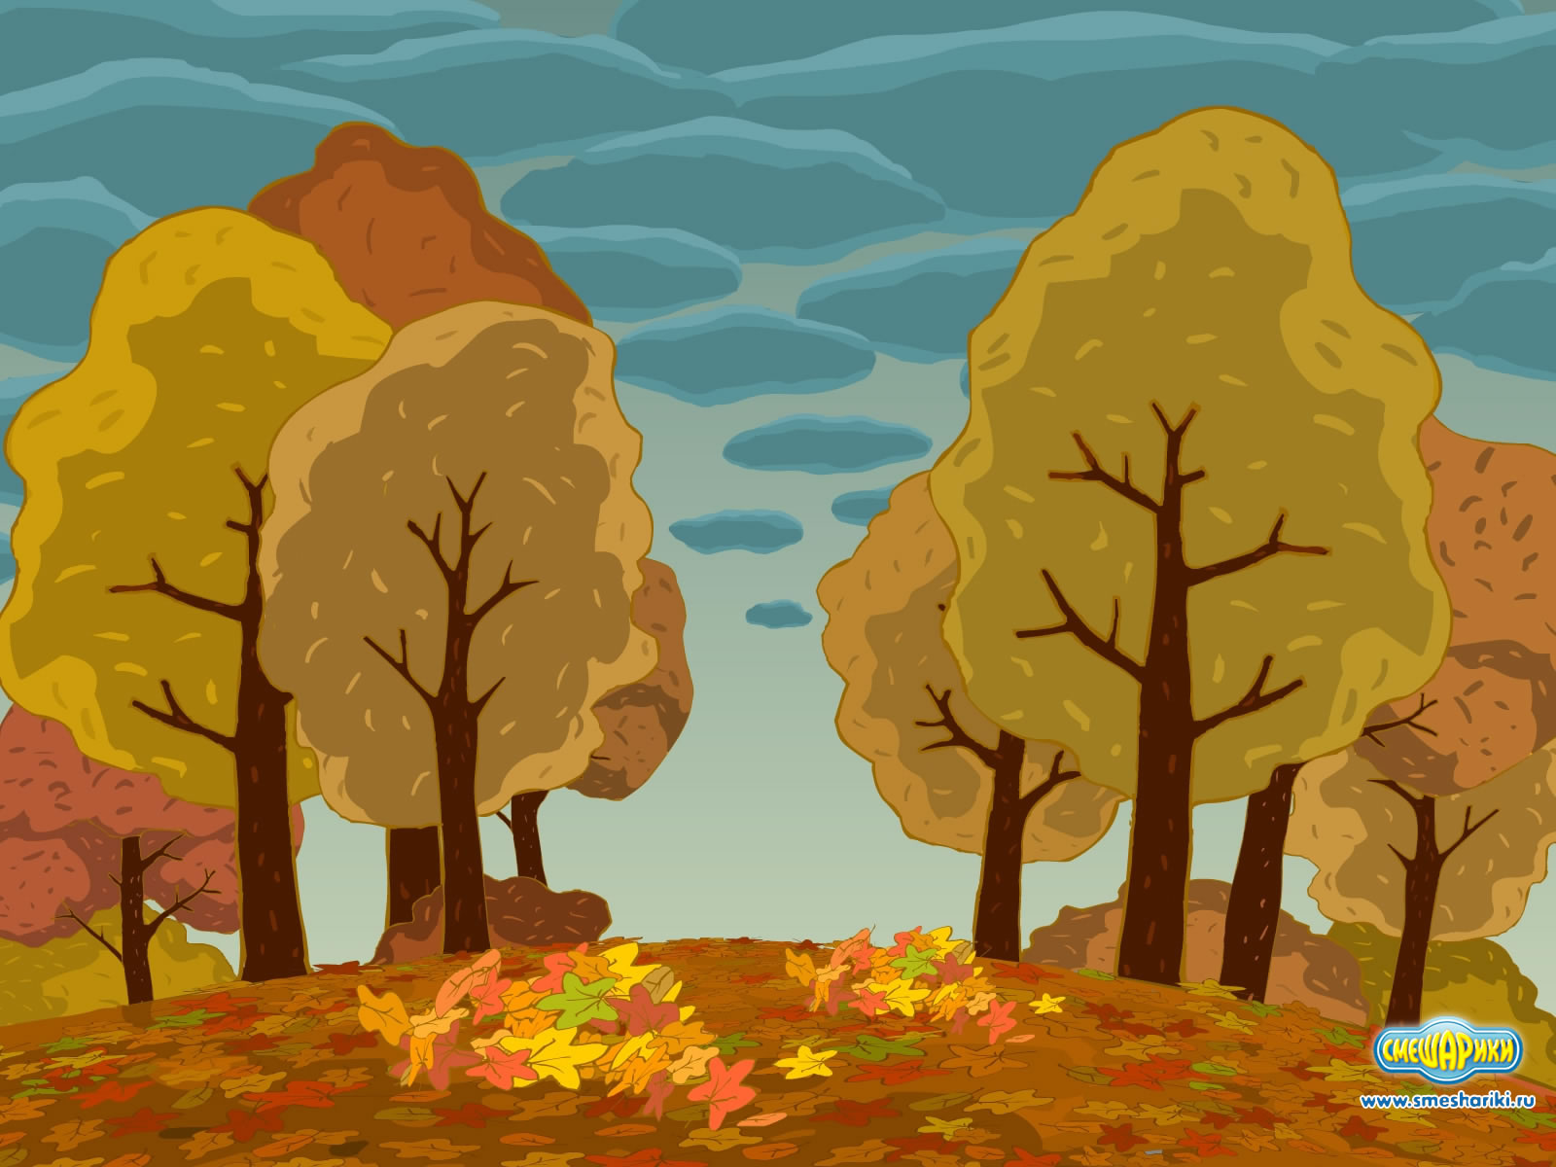
He
in the park.
was
not
We
in the park.
were
not

Slide 18
Как составить вопросительное
предложение?
was
happy.
?
He
were
happy.
?
They

Slide 19
Составьте вопросительные предложения
We were in the park last Sunday.
Were we in the park last Sunday?
They were very happy.
Were they very happy?
He was a very good boy.
Was he a very good boy?
I was at school yesterday.
Were you at school yesterday?

